Slide 1


Humic Acid Removal
Investigating how coagulant dosages affect humic acid concentrations in water
More at https://github.com/AguaClara/humic_acid/
Lynn Shin | ms3244@cornell.edu Rachel Lai | rml267@cornell.edu Annie Hsu | yh533@cornell.edu
Humic Acid Removal | Research | Symposium Presentation Fall 2021

Slide 2
Table of Contents
Background
Schematic Drawing
Experimental Setup
Previous Work
First Steps
Future Work
Humic Acid Removal | Research | Symposium Presentation Fall 2021
Notes:
Cite your sources here.
Caption your figure and explain its relevance to your presentation/thesis here. You can take the caption from your Final Report and modify it.
Write a summary of this slide here. A future team member or client should be able to read this note and understand this slide without having your team explain it to them.
If there are any appendix slides that are relevant to this slide, mention it in your notes.

Slide 3
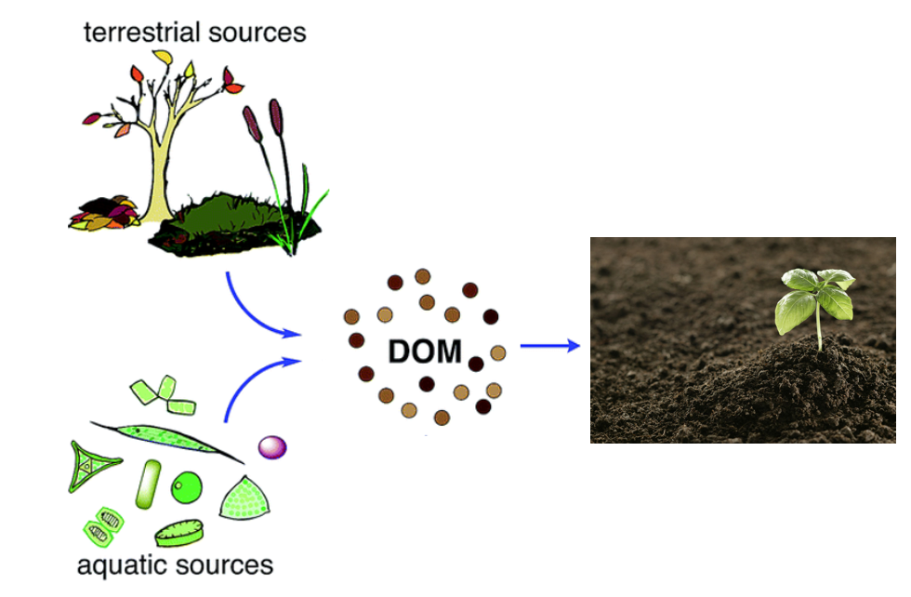
Background
Humic Acid- Dissolved Organic Matter
Creates:
color, taste and odor problems
increased levels of complexed heavy metals and adsorbed organic pollutants
Reacts with chlorine during chlorination - produces harmful byproducts to humans
→ Increased coagulant and disinfectant doses are needed for its removal
Figure 1: Diagram of the formation/ life of dissolved organic material
Humic Acid | Research | Symposium Presentation Fall 2021
Notes:
Humic acid constitutes a large fraction Dissolved Organic Matter (NOM), which is present in surface and groundwater and results from plant and animal decay. Although it is beneficial to plants because of their stimulation of plant growth and increase of plant disease resistance, it is a deterrent for the drinking water treatment process.
Humic acid has a negative effect on water quality by causing color, taste and odor problems, and increased levels of complex heavy metals and adsorbed organic pollutants. In addition, when humic acid reacts with chlorine, a harmful byproduct chloroform is formed.
Thus, we need a higher dosage of coagulant to removal humic acid, but not too much to prevent flocculation.

Slide 4
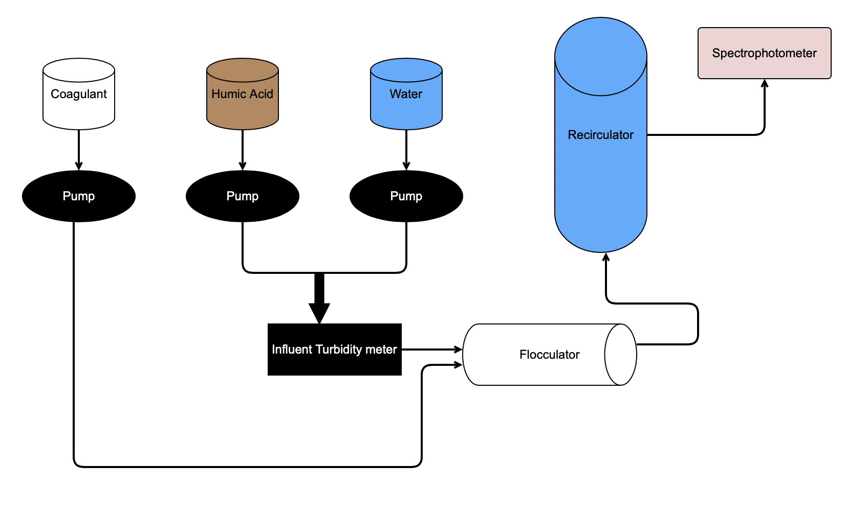
Schematic Drawing
Effluent Turbidimeter
Figure 2: Schematic drawing of the experimental set up for testing varying humic acid and coagulant concentrations
Humic Acid Removal | Research | Symposium Presentation Fall 2021
Notes:
Brief schematic drawing of process/show general flow of solutions”
Water and humic acid are pumped in and combined before entering the influent turbidimeter. Coagulant is added to the humic acid - water solution and enters the flocculator where flocs form. It then moves into the recirculator where the flocs settle in the sedimentation tank. The wastewater travels out from the recirculator and the clear water rises to the top. Then this goes through the spectrophotometer and effluent turbidimeter to measure the absorbance and turbidity of the effluent water.

Slide 5
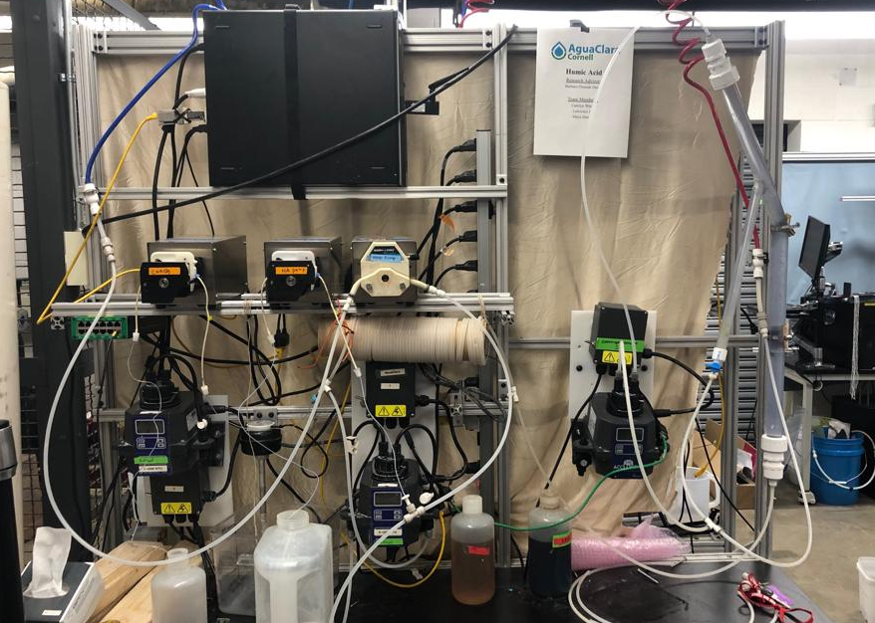
Experimental Design
Water in
Wastewater out
Recirculator
Coagulant pump
Water pump
Humic acid pump
Flocculator
Turbidimeter
Figure 3: Image of lab set-up and experimental design
Humic Acid | Research | Symposium Presentation Fall 2021
Notes:
Three pumps: one for coagulant, HA, and water
Water is pumped from the inlet and combined with the HA, then goes into the turbidimeter
Then combines with coagulant stream and goes into the flocculator, then into the recirculator and sedimentation tank and then the spectrophotometer
Flocs go into the tube settler, then combine with the stream out of the spectrophotometer to go to the wastewater stream out

Slide 6
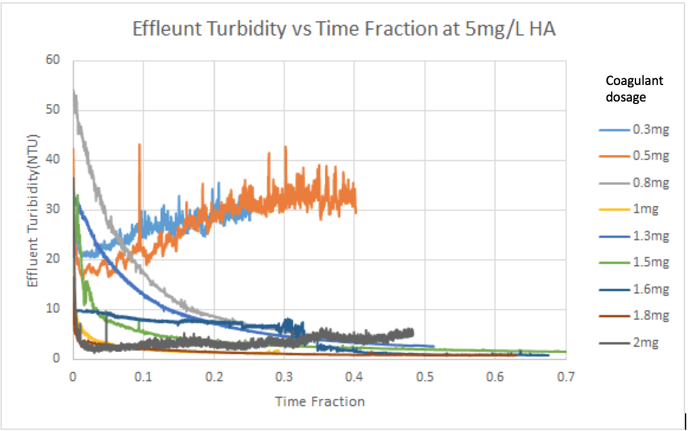
Previous Work
Fall ‘17 and Spring ‘18:
Concentration of Humic Acid (mg/L) | Optimal Coagulant Dosage (mg/L)
5 | 1.6 - 1.8
10 | 1.3
Fall ‘18:
Negative relationship between coagulant dosage and humic acid concentration
Experiments took too long to reach steady state
Figure 4: Absorbance vs. Time Data from Fall ’17/ Spring ‘18 for 5 mg/L of humic acid with various coagulant dosages
Humic Acid | Research | Symposium Presentation Fall 2021
Notes:
After conducting several experiments with different concentrations of coagulant, the 2017-2018 team discovered the optimal coagulant dosage to be 1.6-1.8 mg/L for water with 5 mg/L of humic acid concentration and 1.3 mg/L for 10 mg/L of humic acid concentration. These results show a negative relationship between coagulant dosage and humic acid concentration, which we would like to verify since other literatures have suggested a positive correlation between the two. The team also tried to come up with a mathematical model to calculate the optimal coagulant dosage with known concentration of Humic Acid but the problem was that even with a large change in concentration, the resulting optimal dosage change is small.

Slide 7
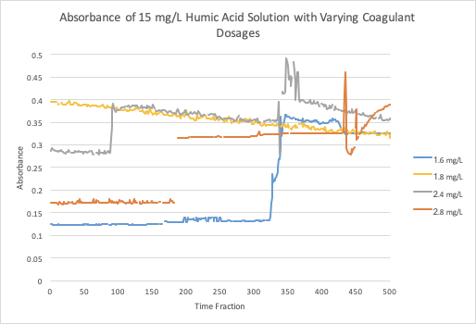
Previous Work
Fall ‘19 and Spring ‘20
Flocs take a long time to form
At higher coagulant dosages around 2-3 mg/L there was very little change of absorbance
Figure 5: Absorbance vs. Time Data from Fall’19 for 15 mg/L at various coagulant dosages
Humic Acid | Research | Symposium Presentation Fall 2021
Notes:
2 years ago, the focus was on increasing the concentration of humic acid and testing different coagulant dosages at each. The team discovered that at higher coagulant dosages around 2-3 mg/L there was very little change of absorbance recorded which indicates that there’s a limit to how much coagulant can be put in before it becomes ineffective.

Slide 8
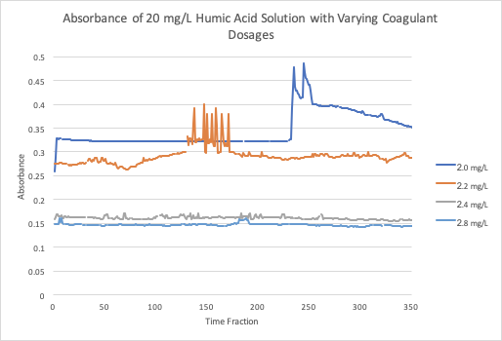
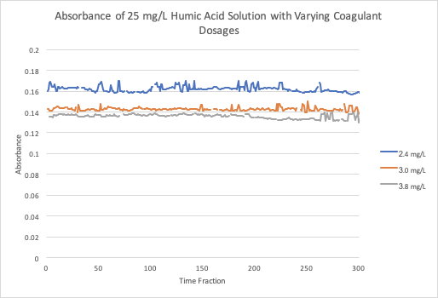
Previous Work
Figure 6: Absorbance vs. Time Data from Fall’19 for 20 mg/L at various coagulant dosages
Figure 7: Absorbance vs. Time Data from Fall’19 for 25 mg/L at various coagulant dosages
Humic Acid | Research | Symposium Presentation Fall 2021
Notes:
As coagulant doses increase, the absorbance of humic acid decreases. This makes sense because higher concentrations of coagulant can form more flocs in the water and thus decrease the effluent turbidity.
There is a limit to the concentration of coagulant on minimizing the amount of humic acid in water.

Slide 9
First Steps
Reviewed past literature about humic acid
Set up most of the experimental design in the lab
Humic Acid Removal | Research | Symposium Presentation Fall 2021
Notes:
And now, we are going to talk about what we have accomplished and hope to accomplish this semester. So far, our team has done literature reviews to gain better understandings of natural organic matter, its effects on drinking water, the relationship between humic acid concentration and coagulant concentration, and how different environmental factors affect this relationship. Also, we have familiarized ourselves with the work done by previous teams and have finished most of the experimental setup. We are still trying to get a spectrophotometer to complete our setup. In the meantime, we are currently learning to use our apparatus and ProCoda so we can run some preliminary experiments as soon as we are ready.

Slide 10
Future Tasks
Finish setting up the experimental design in the lab
Vary concentrations of humic acid and concentrations of coagulant to prove a positive relationship among both solutions
Define steady state
Automate Procoda to run for longer periods of time
Humic Acid Removal | Research | Symposium Presentation Fall 2021
Notes:
Our goals for this semester are to first finish the experimental setup in the lab and then to validate a positive relationship between humic acid concentrations and coagulant dosage by varying the concentrations of both humic acid and coagulant. We will also be working towards defining a steady state, which has not yet been determined by the previous teams, so we can get a sense of when the measurements can be taken to be able to get reliable and contributive data that would allow us to interpret the results, find the correlation, and redesign our experiment more easily and accurately. Another goal that we would like to achieve is to design an automated ProCoda code that would allow experiments to run for longer periods of time without us being present in the lab to start and stop the experiments.

Slide 11
Questions
and
Recommendations
Lynn Shin | ms3244@cornell.edu
Rachel Lai | rml267@cornell.edu
Annie Hsu | yh533@cornell.edu
Humic Acid Removal | Research | Symposium Presentation Fall 2021
Notes:
Lynn Shin | ms3244@cornell.edu Rachel Lai | rml267@cornell.edu Annie Hsu | yh533@cornell.edu

Slide 12
Bibliography
Logan, B. E., Hermanowicz, S. W., & Parker, A. S. (1987). A Fundamental Model for Trickling Filter Process Design. Journal (Water Pollution Control Federation), 59(12), 1029–1042.
Matilaninen, A, Vepsalainen, M & Sillanpaa, M. (2010). Natural Organic Matter Removal by Coagulation during Drinking Water Treatment. Adv Colloid Interface Sci.
Soh, YC, Roddick, F & Van Leeuwen, J. (2008). The Impact of Alum Coagulation on the Character, Biodegradability and Disinfection By-product Formation Potential of Reservoir Natural Organic Matter (NOM) Fractions. Water Sci Technol. 58(6), 1173-9.
Kopfler, F., H. Ringhand, W. Coleman, AND J. Meier. REACTIONS OF CHLORINE IN DRINKING WATER, WITH HUMIC ACIDS AND 'IN VIVO'. U.S. Environmental Protection Agency, Washington, D.C., EPA/600/D-84/196 (NTIS PB85160737).
Du, Y. (2017). Observations and a Geometric Explanation of the Effects of Humic Acid on Flocculation.
Humic Acid| Research | Symposium Presentation Fall 2021
Notes:
-Carolyn

Slide 13
Appendix
Slides
Humic Acid Removal | Research | Symposium Presentation Fall 2021
Notes:
This semester, the Humic Acid Removal subteam began work in the lab by familiarizing ourselves with equipment and past work done by previous teams. Moving forward, we are working towards validating the relationship between optimal coagulant dosage and humic acid concentration in order to effectively remove the humic acid from the water in substandard conditions. The team has set up a system in which the effectiveness of the coagulant dosage is evaluated by pumping water, humic acid, and coagulant through an influent turbidimeter, a flocculator, a recirculator, a spectrophotometer, and an effluent turbidimeter.

